Slide 1
Expectation Maximization example

Slide 2
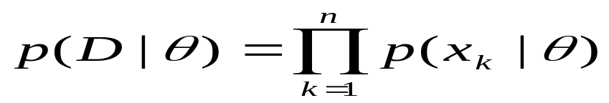
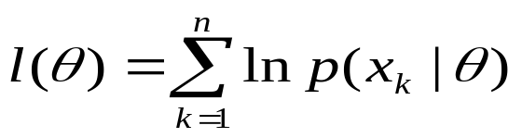
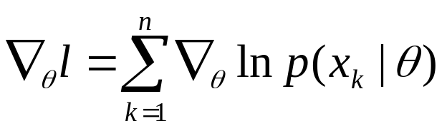
Maximum Likelihood Estimation
maximizes p(D | θ).
Or l(θ ) = ln p(D | θ)

Slide 3
Expectation Maximization
Dataset D = {x₁, x₂, …, x_{n}}
Each example may have some features missing, a point or example x can be written as
x = {x_{g}, x_{b} }
meaning it has good features x_{g} and missing or bad features x_{b}.
instead of maximizing p(D | θ)
We maximize Expectation of p(D | θ) with respect to x_{b}

Slide 4

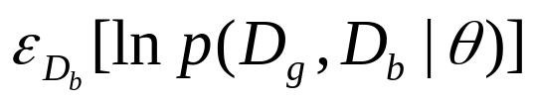
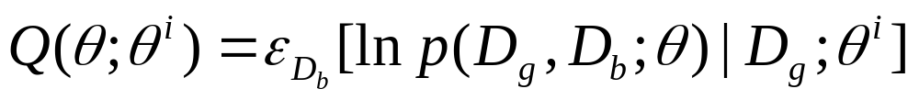
Expectation Maximization
For a fixed example x let D_{g} be the good features set and D_{b} be the bad features set with
Expectation of ln p(D | θ):
We form the following function

Slide 5
Algorithm
begin
Initialize θ^{i} , i = 1;
  Do
  E step: compute Q(θ ; θ^{i} )
  M step: θ^{i+1} = arg max Q(θ ; θ^{i} )
  i = i + 1;
  Until Q(θ^{i+1} ; θ^{i} ) - Q(θ^{i} ; θ^{i-1} ) <= T
Return θ^{i+1}
End
The algorithm is guaranteed that the log-likelihood of the data will
increase monotonically.

Slide 6
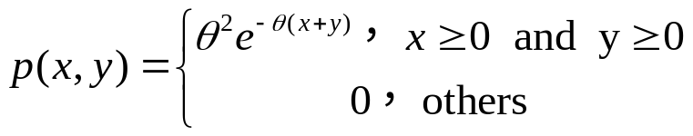
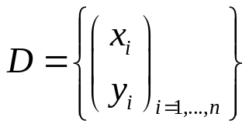
EM example
θ>0
All y_{i} are missed, estimate θ

Slide 7
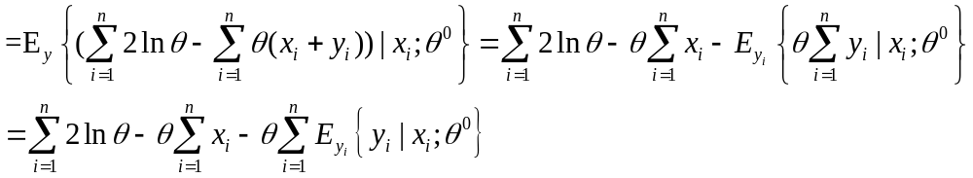

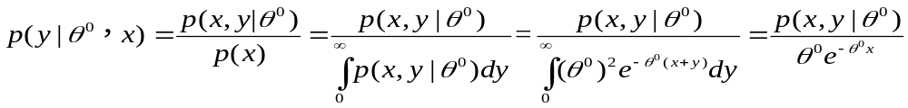
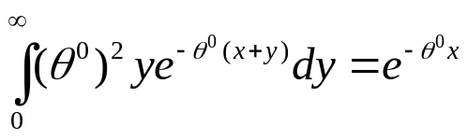
E step

Slide 8
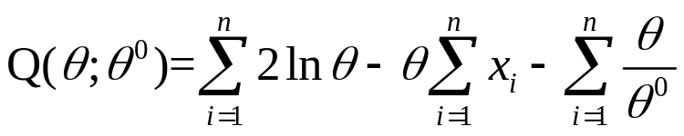
E Step (cont’)
so

Slide 9
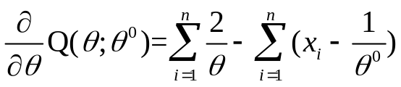
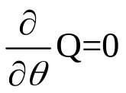
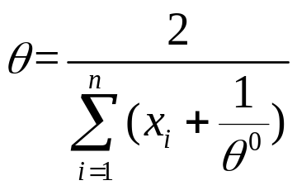
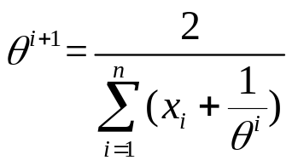
M step
let
so

